Slide 1

Learn Solidity in 15 minutes
@victaphu
harmony.one

Slide 2
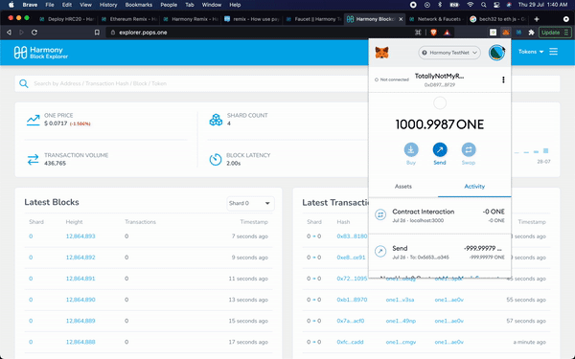
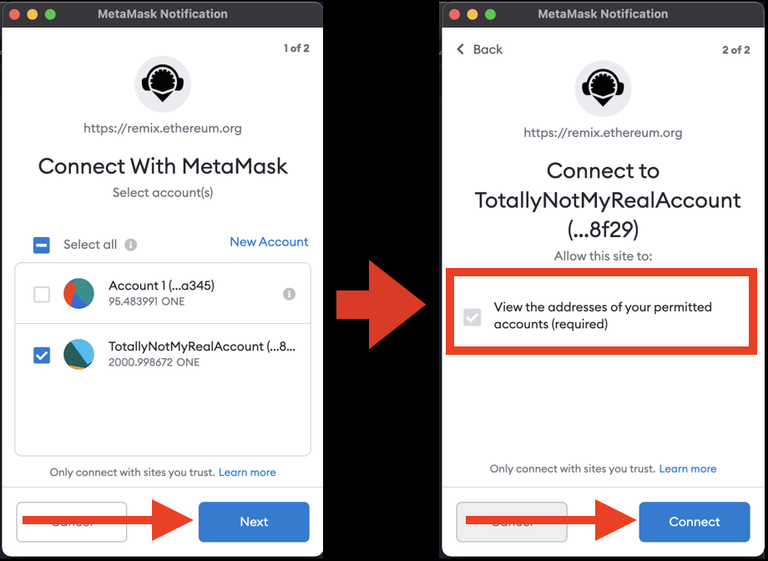
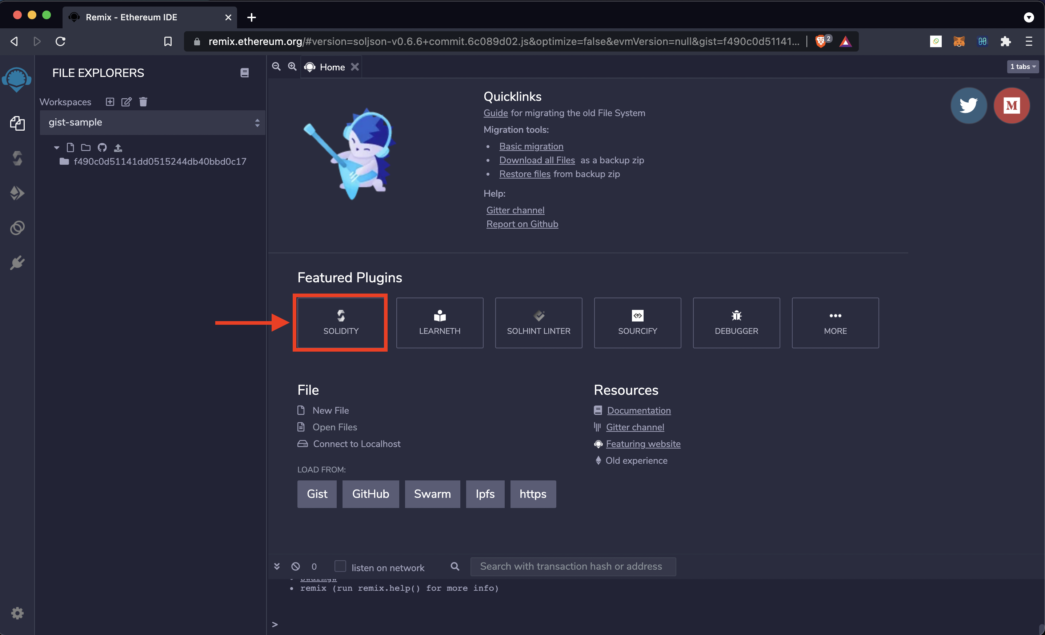
Harmony: Learning Solidity
Deploy and interact with a sample Solidity Smart Contract
Walk through common language constructs

Slide 3
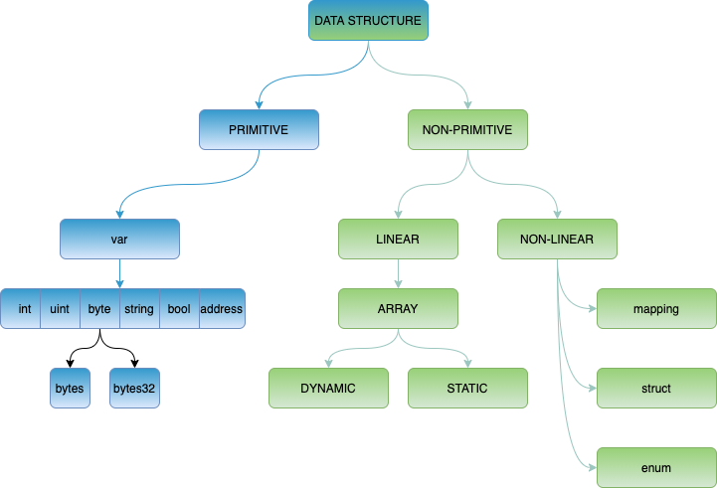
Solidity: Data Type and Data Structures
Primitive Types
There are no doubles/floats. Numeric values represented as signed/unsigned integer
Can explicitly define the size (8 bit, 16 bit, etc at 8 bit increments up to 256 bit)
Data Structures and Non-primitive types
Linear array structures can be dynamic or static
Mapping type has key / value access
But cannot iterate without knowing the keys!
Data structures can be nested
Can specify the data location (storage, memory, call data)
Data structures and primitives can be deleted

Slide 4
Solidity: Operators
Solidity supports a standard set of operators similar to languages such as Javascript and C
Operator Type | Symbols
Arithmetic Operators | +, -, /, *, %, ++, --, **
Relational Operators | ==, !=, <, <=, >, >=
Logical Operators | &&, ||, !
Bitwise Operators | &, |, ^, ~, <<, >>
Assignment Operators | =, +=, -=, *=, /=, %=
Conditional Operator | a==b ? f1() : f2()
Source: https://www.geeksforgeeks.org/solidity-operators/

Slide 5
Solidity: Global Variables
Type | Variable | Description
this | this, this.balance, this.somefunc() | Called within a contract function to reference the contract itself. Dot-notation to call functions (e.g. somefunc())
msg | msg.sender, msg.value, msg.data, msg.gas | Current message received by the contract. msg variable is accessible within contract functions
tx | tx.origin, tx.gasPrice | The tx variable can be accessed in the contract function. tx.origin is the external account that started the transaction, while msg.sender is the immediate account that invoked the function
block | block.number, block.difficulty, block.blockHash(1), block.gasLimit(), now | The block variable contains information about the current block. “now” is a variable that gives current UNIX timestamp (similar to block.timestamp).
Source: https://docs.soliditylang.org/en/latest/units-and-global-variables.html

Slide 6

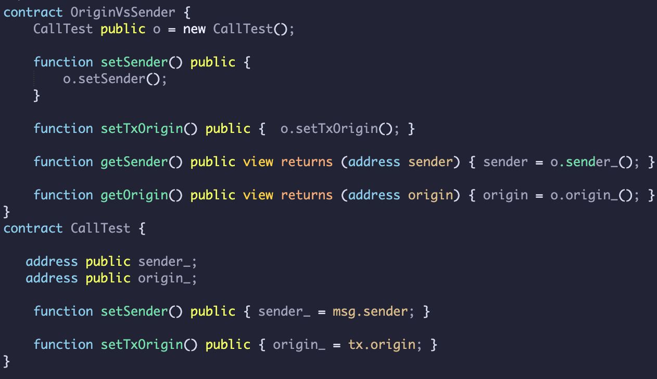
Solidity: Global Variables
Address of OriginVsSender = ‘A’
Caller = ‘B’
OriginVsSender.setSender()
OriginVsSender.setOrigin()
What is the result of:
OriginVsSender.getSender()
OriginVsSender.getOrigin()
?
OriginVsSender.getSender() would return msg.sender (the contract address, ‘A’)
OriginVsSender.getOrigin() would return tx.origin (the Caller Address ‘B’)
Test it out here (see link in video description)

Slide 7
Solidity: Functions
function increment(uint x, uint y) returns (uint x, uint y) {
x += 1;
y += 1;
}
Functions can have multiple return types and function modifiers (returns, public, view, etc).
View and Pure functions are executed locally (not on the blockchain) and do not change state. Pure functions are more restrictive, and does not even allow reading of state variables.
Function Visibility Specifiers control access to functions:
public - visible externally and internally (default for function)
external - only visible externally (including a call made with this.)
private - only visible in the current contract
internal - only visible in current contract, and those deriving from it
Functions can only receive ONE tokens if they have “payable” modifier

Slide 8
Solidity: Events and Modifiers
Events - Defined in the Smart Contract
- Fired from within the Smart Contract to notify all external listeners that something of interest has occurred
Can store data that is persisted and immutable (stored in each blockchain node)
Data stored in this way can be queried by external callers, but cannot be accessed by the smart contract
Modifiers
Validate inputs to functions (e.g. min balance, user auth)
Similar to “guard” clauses in other languages

Slide 9
Solidity: Function, events, and modifiers
What is the key difference between a public function and an external function?
public - visible externally and internally (default for function)
external - only visible externally (including a call made with this.)
If a function will only be used externally (never called from within the smart contract) then it should be marked external for gas cost savings (and as best practice)
What is a limitation of event messages and why can’t we use it to store data for our smart contract?
Events are stored with the blockchain and are immutable. However they can only be accessed externally; smart contracts do not have access to the stored events

Slide 10
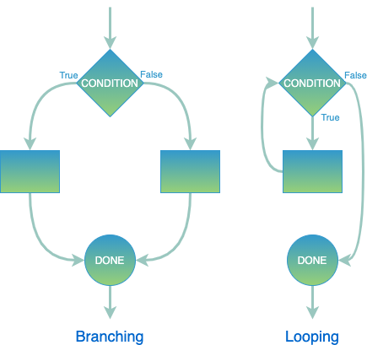
Solidity: Branching and Loops
All basic logic blocks work (if/else, for, while, break, continue, return) - switch/case not supported
The syntax is the same as Javascript, but no automatic conversion to bool
Be wary of using user behaviour as loop condition as contracts have max gas (can run out)

Slide 11
Solidity: Branching and Loops
What are some issues with the code below?
for(uint x = 0; x < refundAddressList.length; x++) {
refundAddressList[x].transfer(SOME_AMOUNT);
}
Transfer function may throw an exception (and stop the loop from completing)
This loop could be arbitrarily long (based on the amount of users who need refunds), and therefore may always fail as it exceeds the max gas for a block
Note: You should design the contract so individual people can withdraw from their accounts and mark as withdrawn. e.g. favour pull payments over push payments

Slide 12
Solidity: Objects/Contracts
Launch Example

Slide 13
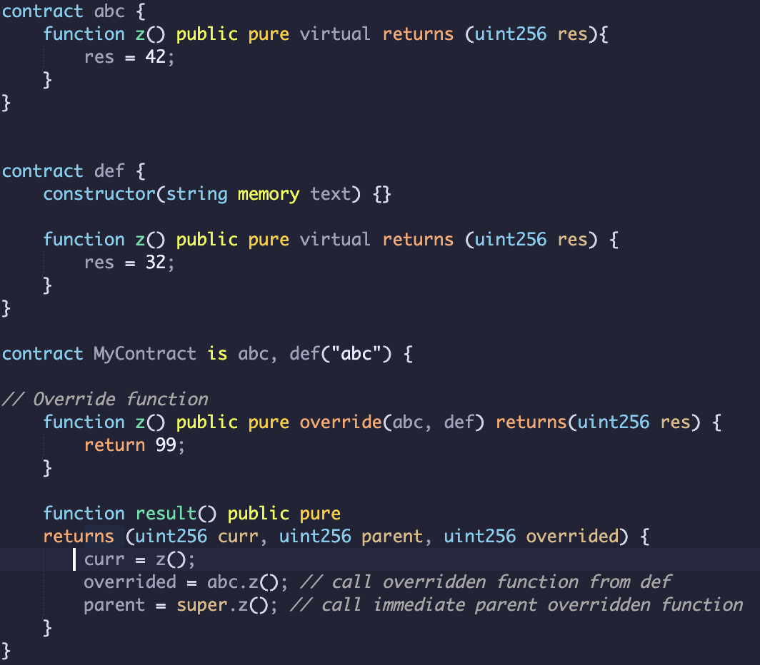
Solidity: Objects/Contracts
What will be the result of calling MyContract.result()?
curr = 99
parent = 32
overrided = 42
When overriding multiple base contracts with the same function signature the last contract in the inheritance list will be used (e.g. def.z() )

Slide 14
Solidity: Other Keywords
// selfdestruct current contract, sending funds to address (often creator)
selfdestruct(SOME_ADDRESS);
// removes storage/code from current/future blocks
// helps thin clients, but previous data persists in blockchain
// Common pattern, lets owner end the contract and receive remaining funds
function remove() {
if(msg.sender == creator) { // Only let the contract creator do this
selfdestruct(creator); // Makes contract inactive, returns funds
}
}
// May want to deactivate contract manually, rather than selfdestruct
// (ether sent to selfdestructed contract is lost)

Slide 15
Solidity: Contract Design Notes
Obfuscation
All Data is publicly visible. Use cryptography to obfuscate
Storage Optimisation
Writing to blockchain is expensive! Data structure planning can help reduce costs
Data Access
Private function/data prevents contracts from accessing and viewing the data programatically; however the data is still visible on the blockchain and can be inspected
Oracles and External Data
Oracles allow you to supply data to the smart contract from external sources.
Cron Jobs
Cron Job should be setup for contracts that must be manually called for time-based scheduling
Observer Pattern
Similar to pub/sub model (note the potential issues with gas and errors …)

Slide 16
Solidity: Objects/Contracts
Why is it a bad idea to store sensitive data unencrypted on the blockchain?
While we can mark a state variable as private it does not prevent anyone from inspecting the block the transaction occurred in to derive the value.
While 'private' prevents other *contracts* from reading data directly - any other party can still read data in blockchain
All data to start of time is stored in blockchain, so anyone can observe all previous data and changes

Slide 17
Solidity: Some more functions
// Currency units
// Currency is defined using wei, smallest unit of Ether
uint minAmount = 1 wei;
uint a = 1 ether;
// Other units, see: http://ether.fund/tool/converter
// NOTE: as of Solidity version 0.7.0, finney and szabo denominations have been
// removed from the Solidity language
// Time units
1 == 1 second
1 minutes == 60 seconds
// Can multiply a variable times unit, as units are not stored in a variable
uint x = 5;
(x * 1 days); // 5 days
// Careful about leap seconds/years with equality statements for time
// (instead, prefer greater than/less than)
// Cryptography
// All strings passed are concatenated before hash action
sha3("ab", "cd");
ripemd160("abc");
sha256("def");
Source: https://docs.soliditylang.org/en/latest/units-and-global-variables.html

Slide 18
Solidity: Security
Bugs can be disastrous in Ethereum contracts - and even popular patterns in Solidity, may be found to be antipatterns.
Famous ones include the DAO attack that split Ethereum into ETH and ETC (Ethereum Classic).
A list of security related articles are provided in the document accompanying this tutorial
Source: https://medium.com/ngrave/the-history-of-crypto-hacks-top-10-biggest-heists-that-shocked-the-crypto-industry-828a12495e76

Slide 19
Solidity: Low-level function calls
// call - low level, not often used, does not provide type safety
successBoolean = someContractAddress.call('function_name', 'arg1', 'arg2');
// callcode - Code at target address executed in *context* of calling contract
// provides library functionality
someContractAddress.callcode(‘function_name');

Slide 20
Harmony: Putting it all together
Remix Demo

Slide 21

On-Chain Bridges & Wallets
harmony.one/strategy
Developers & Community 💙 DAO
harmony.one/ecosystem
Cross-Chain Finance & Digital Arts
harmony.one/roadmap
$10M Bounties, We are HIRING!
harmony.one/bounties
@stse s@harmony.one

